Slide 1
Git简介 & 软件的安装与配置

Slide 2
目录
计算机操作系统简介(10min)
Git与Github的简单使用(60min)
Anaconda的安装与配置(5min)
Visual Studio Code的安装与配置(5min)
Python程序的两种运行模式(10min)

Slide 3
一. 计算机操作系统简介

Slide 4
三大操作系统
Windows
UNIX
Linux

Slide 5
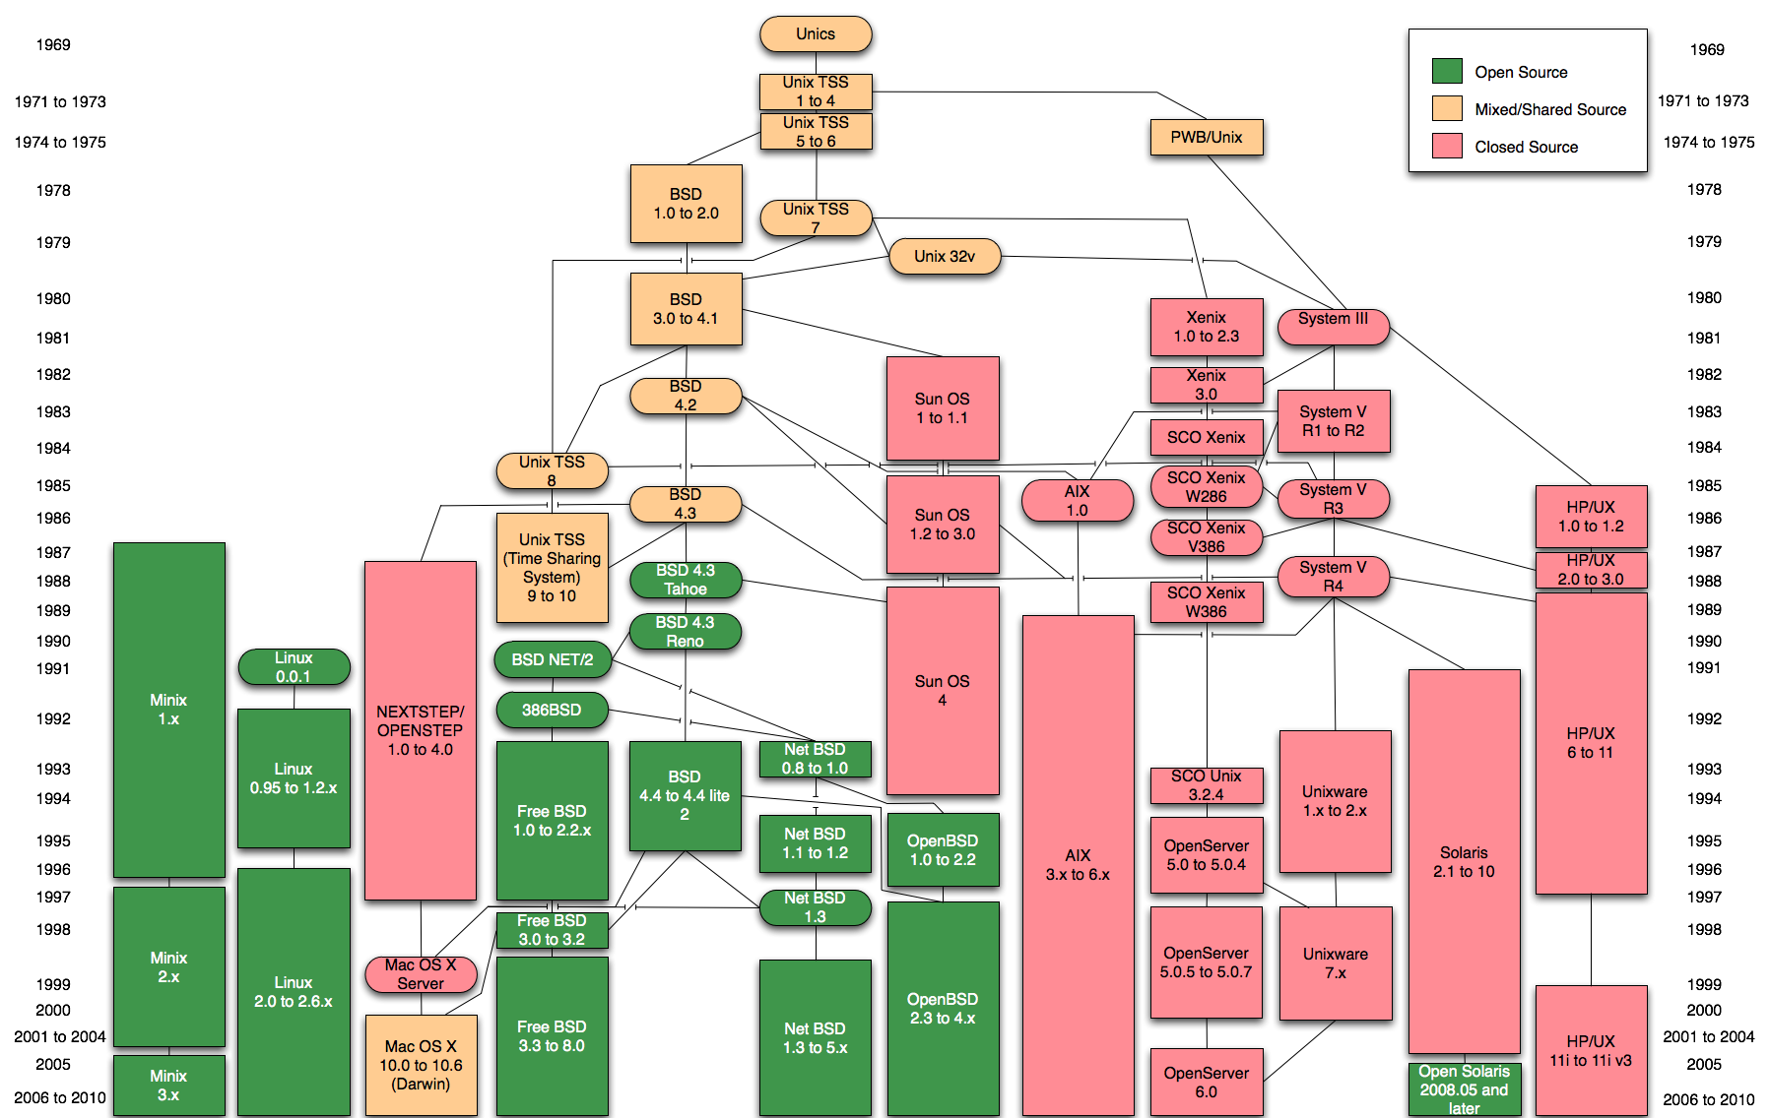

Slide 6
Shell
Bash
Cmd
PowerShell

Slide 7
最常用的4个Bash命令
cd
pwd
ls/dir
clear/cls

Slide 8
二. Git与Github的简单使用

Slide 9

Git is one of the most popular version control system(VCS). It is a mature, actively maintained, open source project compatible with many operating systems and IDEs

Slide 10
Git常用命令
git init
git status
git add .
git commit –m [备注]
git log
git branch
git branch [分支名]
git checkout [分支名/SHA1]

Slide 11












Slide 12

The world‘s leading software development platform. GitHub is an American company that provides hosting for software development version control using Git.

Slide 13
Git常用命令(续)
git clone [url]
git pull origin master
git push origin master

Slide 14
Github特色功能
Fork
Pull Request
Issue

Slide 15
三. Anaconda的安装与配置

Slide 16

Anaconda = Python + conda + a lot of data science packages + tools like Jupyter Notebook

Slide 17
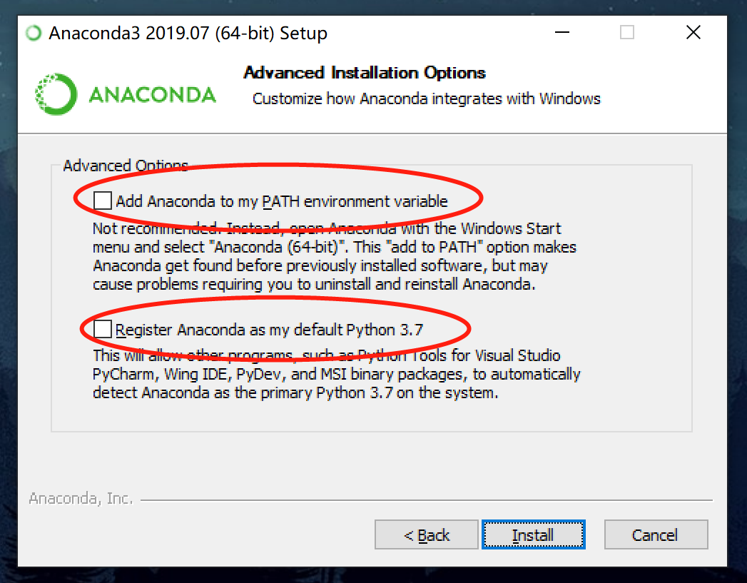
安装过程中的注意事项
第一，安装路径最好全部都是英文；
第二，到下面这一步时，两个都打勾：

Slide 18
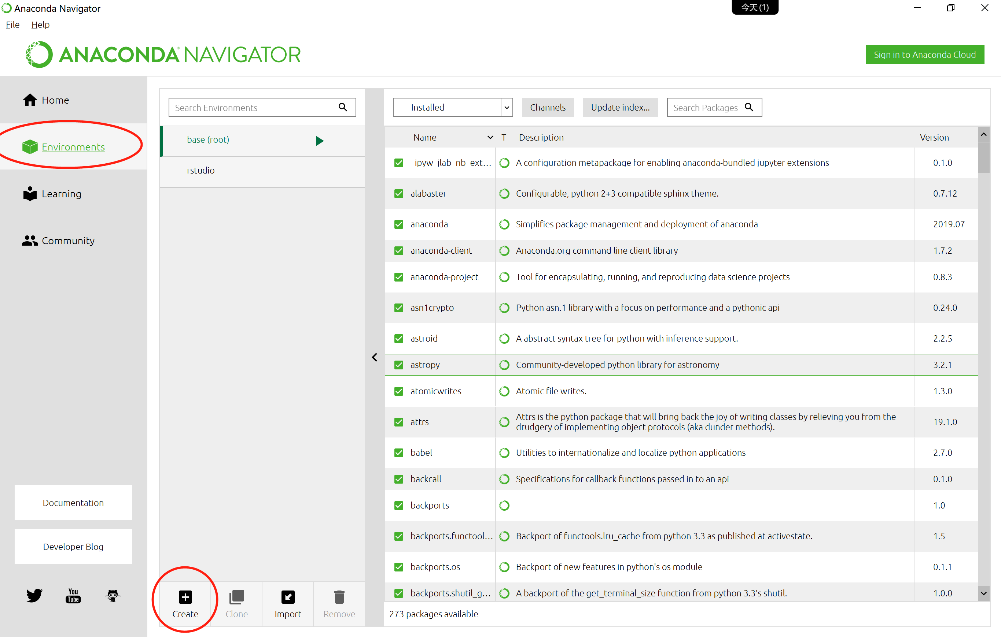
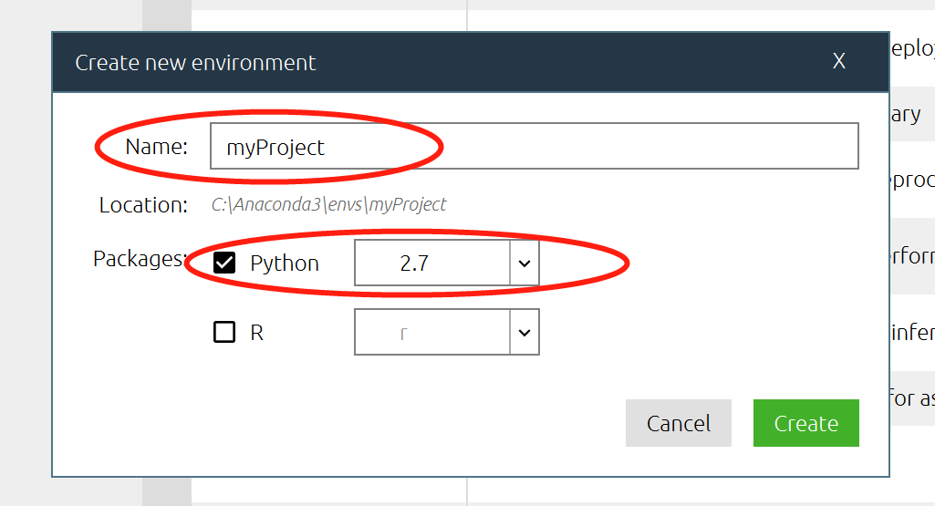
环境管理

Slide 19
四. Visual Studio Code的 安装与配置

Slide 20

Visual Studio Code is a lightweight but powerful source code editor which runs on your desktop and is available for Windows, macOS and Linux.

Slide 21
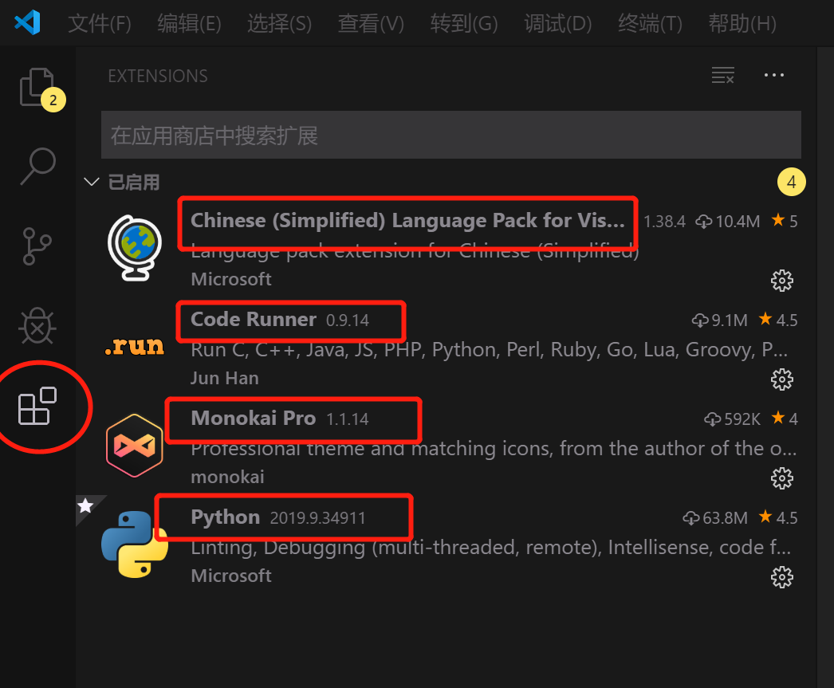
常用插件

Slide 22
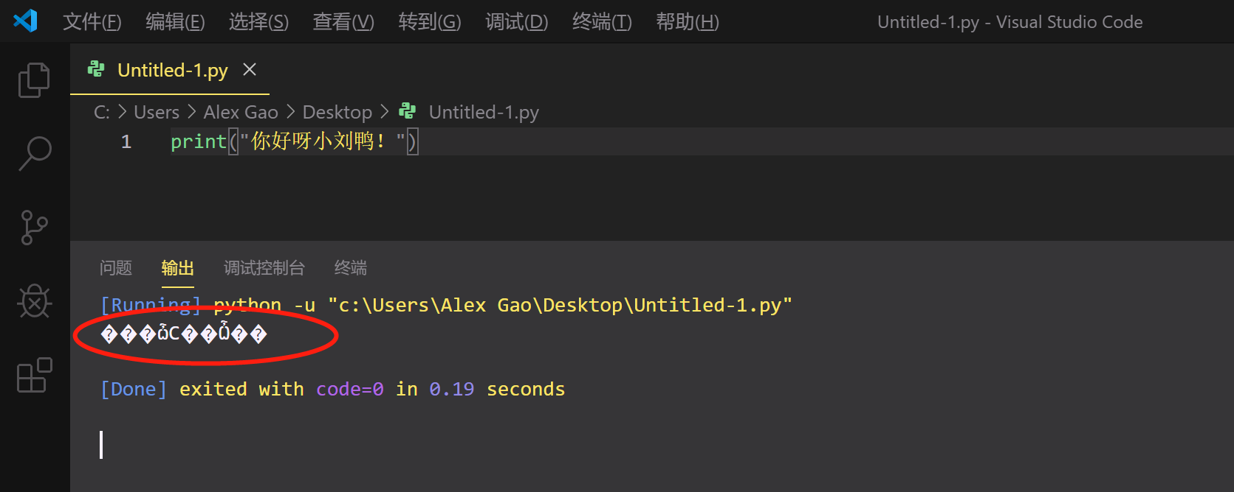
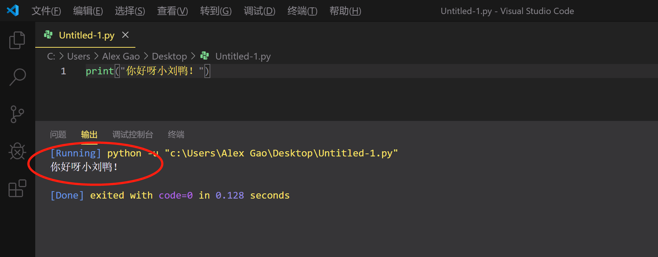
解决输出为中文乱码
添加系统变量：PYTHONIOENCODING=UTF8

Slide 23
五. Python程序的两种运行方式

Slide 24
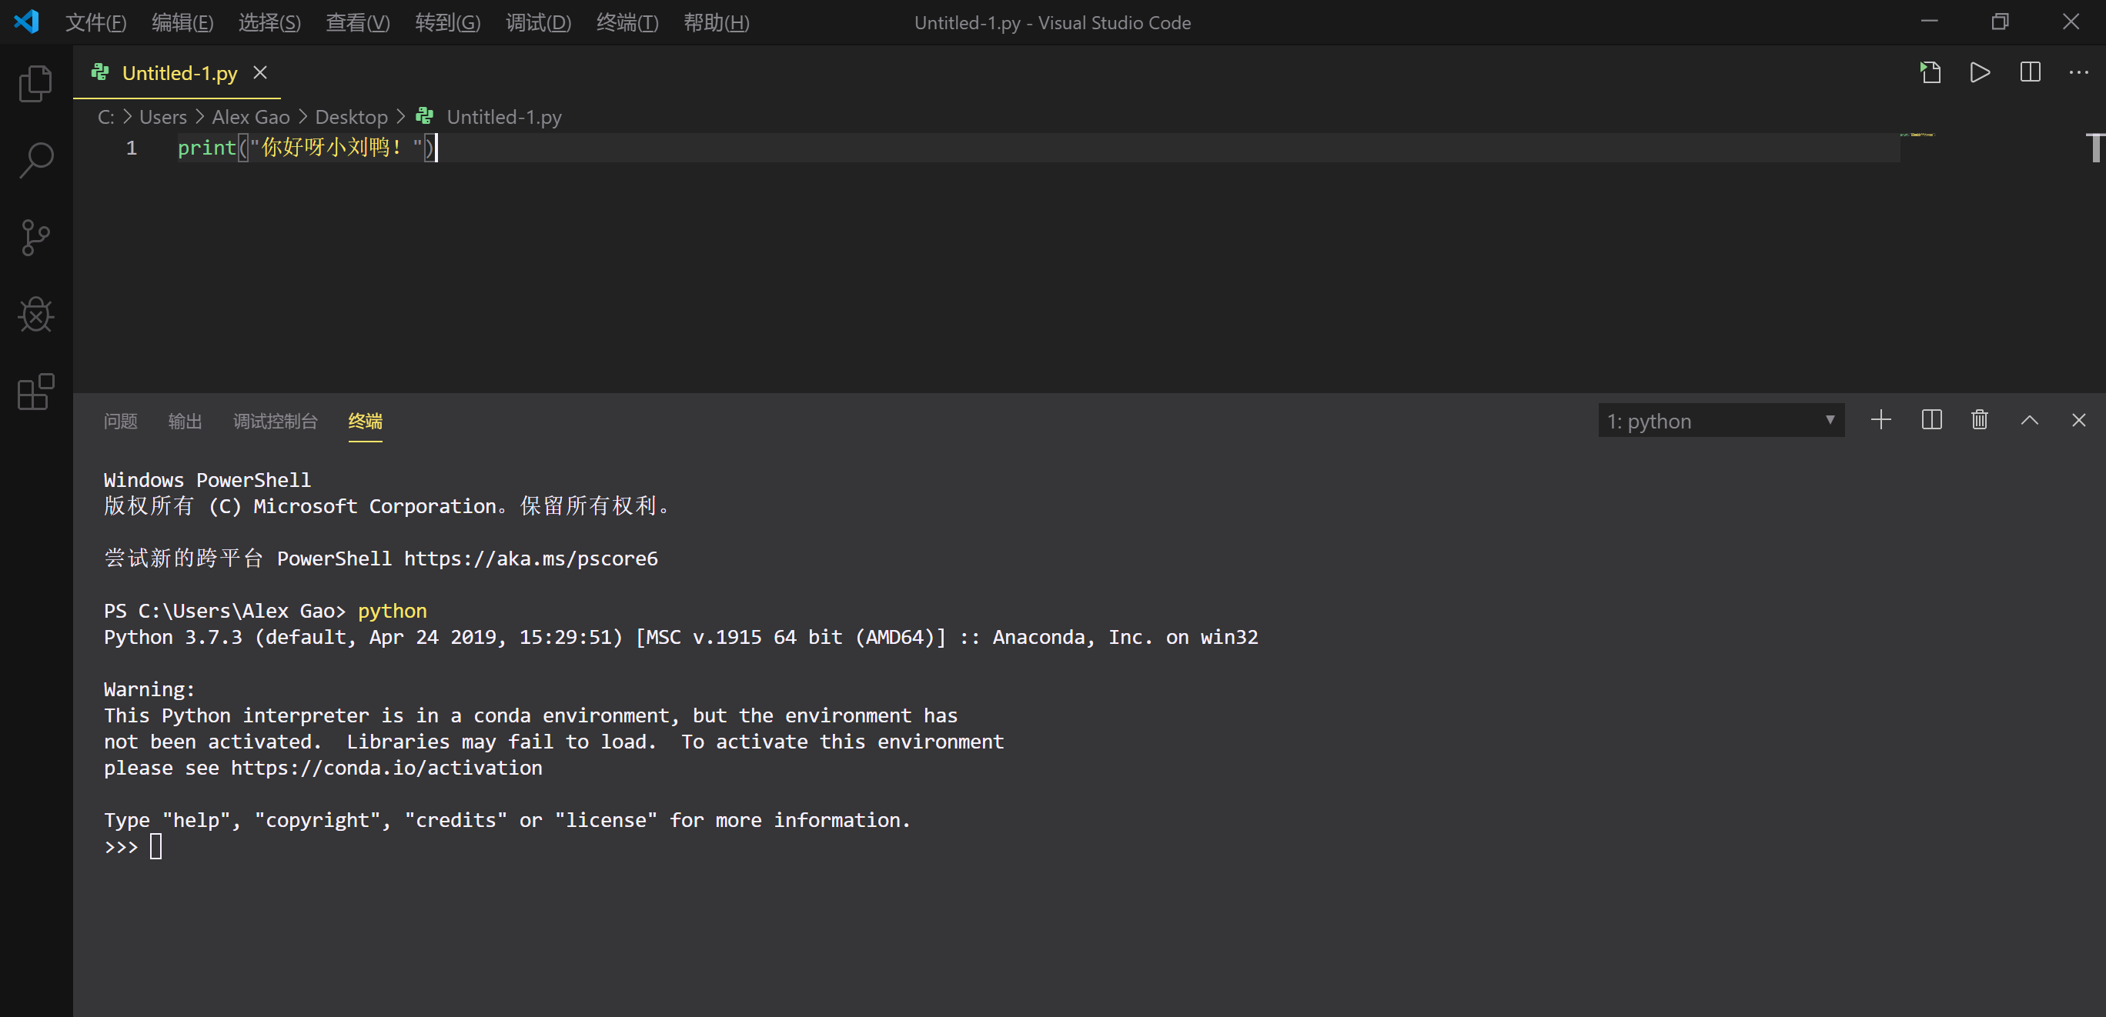
两种方式
交互式环境——退出消失，熟悉语法；
脚本：保存为文件运行——持久化，复杂逻辑。

Slide 25
参考资料
How Git Works, by Paolo Perrotta
https://app.pluralsight.com/library/courses/how-git-works/table-of-contents
Git & Github for Poets, by DANIEL SHIFFMAN
https://www.bilibili.com/video/av4857819?from=search&seid=5402638418024823626
Github guides
https://guides.github.com/activities/hello-world/
Github三分钟动画
https://www.bilibili.com/video/av22364515?from=search&seid=28319987935970953

